Slide 1

From Hardship to Hope:
VADER Analysis of Sentiment in U.S. Inaugural Speeches
Orange 7 - Clayton Casper, Landon Docherty,
Macy Faw, Kyle Hardy, Cassidy Morales
Notes:
Title - > change icons
Are entire team on the hook?

Slide 2
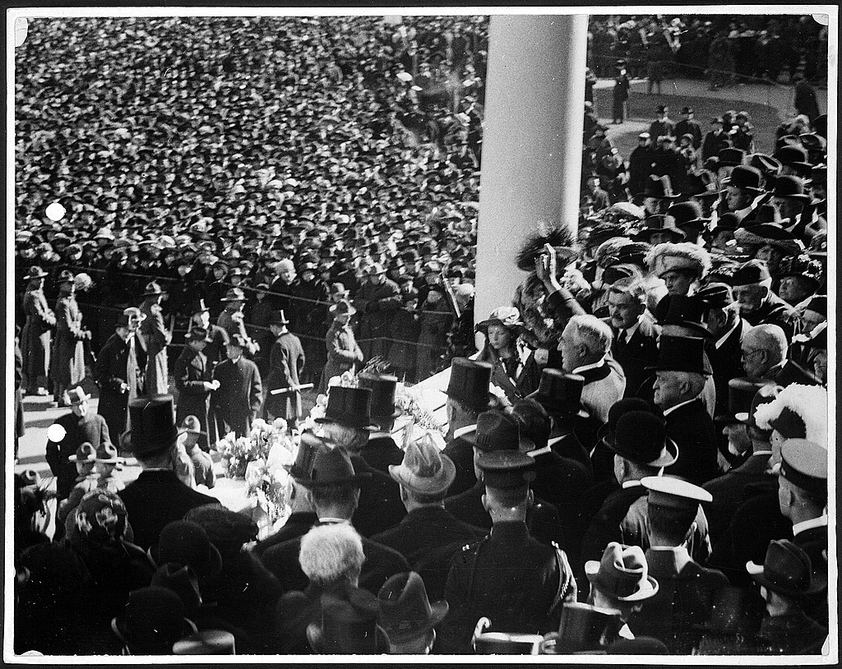
Of the 3 speeches analyzed, VADER determined sentiment with…
20.5% false positives
16.4 % false negatives
…on average.
Inauguration of 29th President Warren G. Harding (1921)
Notes:
Sentiment v. Valence
Need better idea - visuals, need different colors (not blue or red)

Slide 3
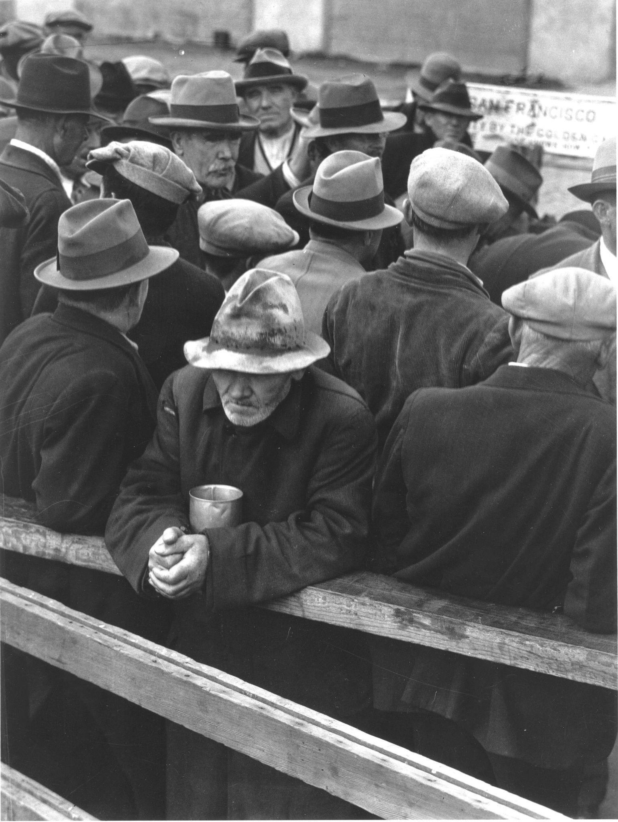
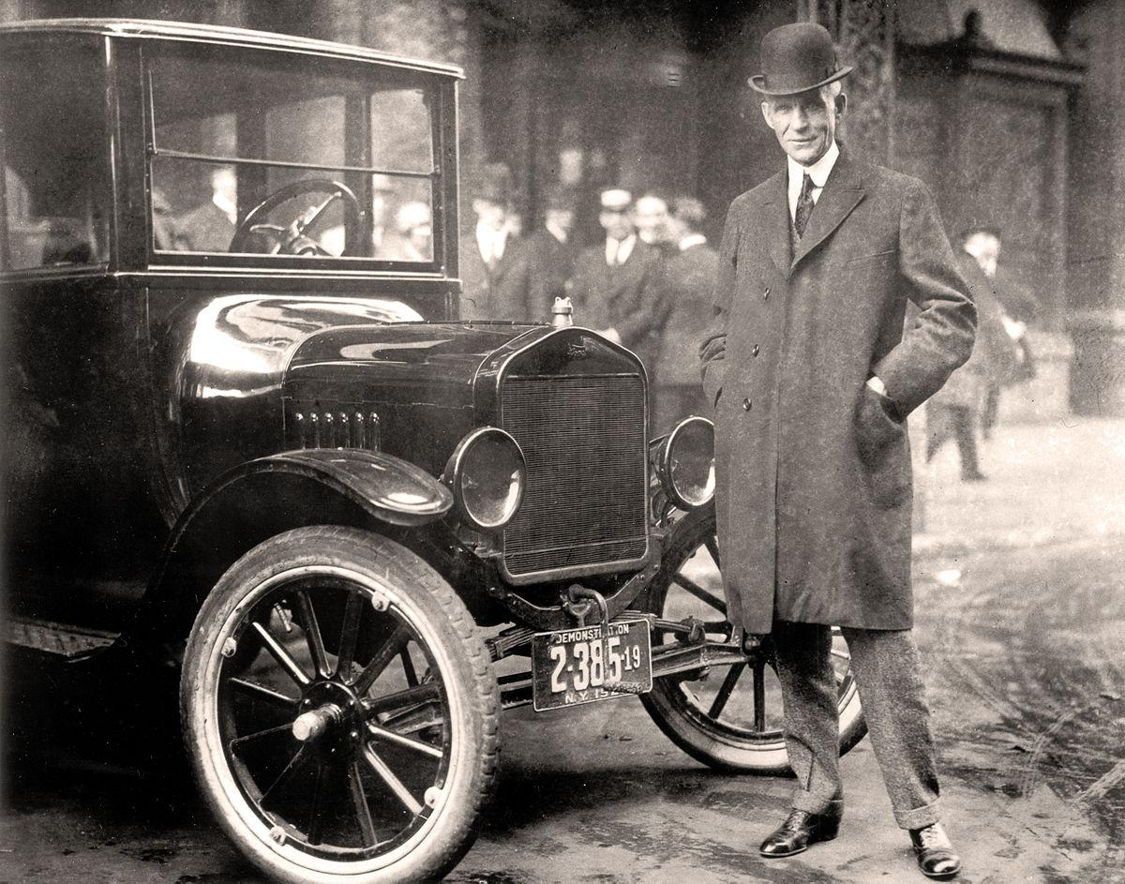
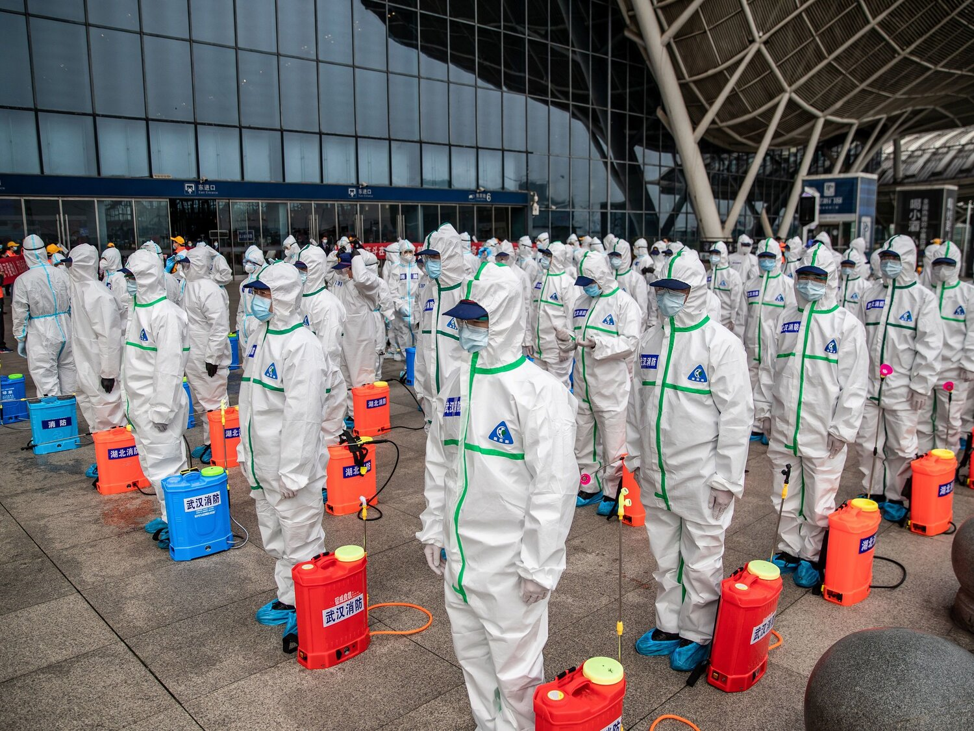
1921
2020
1933
The Roaring 20s
COVID-19
Lang. D. “White Angel Bread Line, San Francisco”
The Great Depression
H. Ford and the Model-T
Workers preparing to disinfect a central railway station
Notes:
Do we want breadcrumbs? No. What about titles?No
Text for the COVID-19 image. Can this be agenda and transition slide?
Number of slides?

Slide 4
1921
The Roaring 20s
H. Ford and the Model-T
Notes:
Do we want breadcrumbs? What about titles?; Text for the COVID-19 image. Can this be agenda and transition slide?

Slide 5
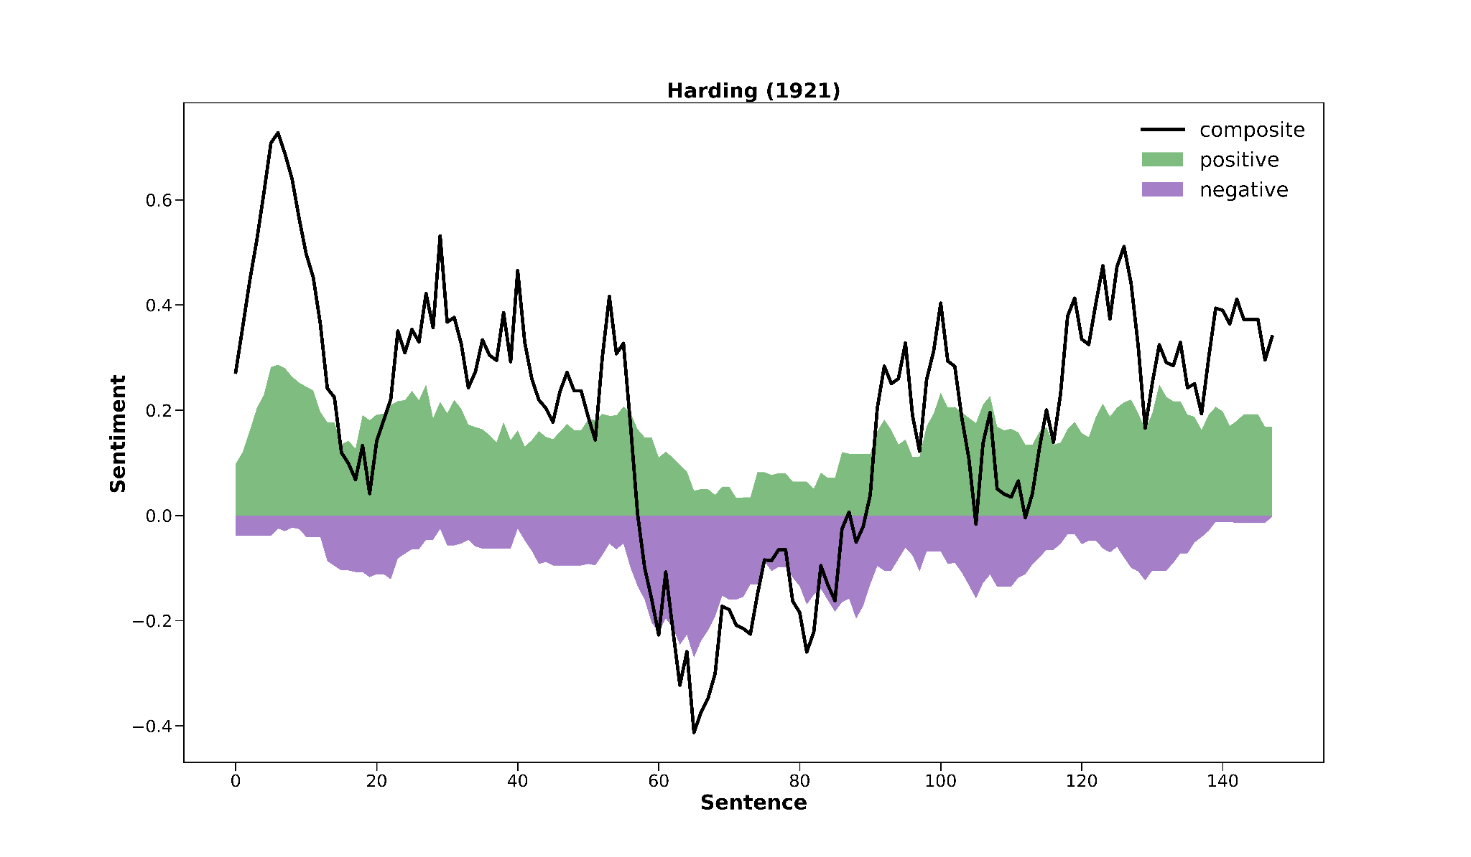
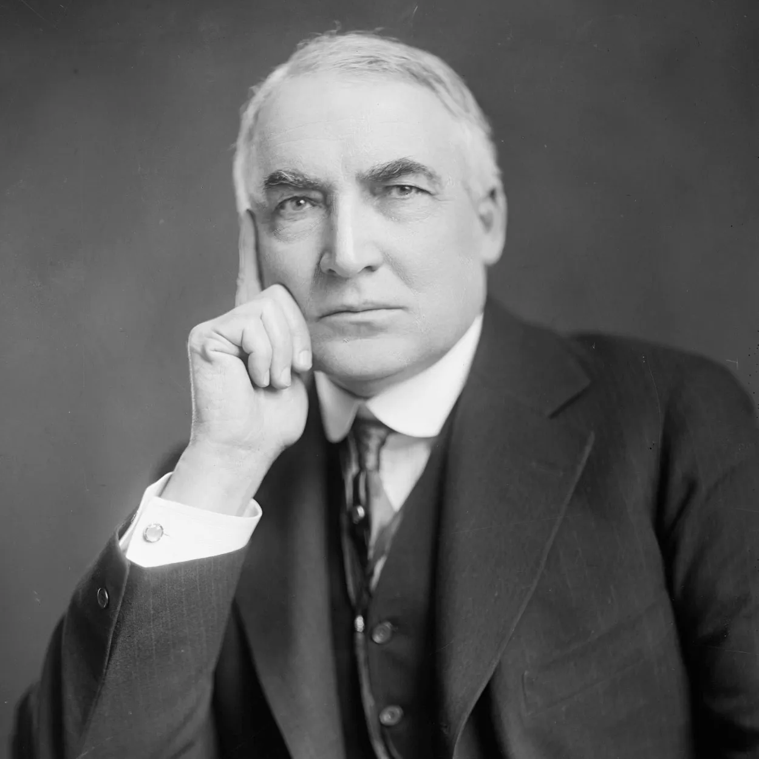
Notes:
This inauguration was the first in which an automobile was used to transport the president-elect

Slide 6
—Warren G. Harding
We crave friendship and harbor no hate.
Compound: -0.4588 Neg: 0.461 Neu: 0.312 Pos: 0.227

Slide 7
1921
1933
The Roaring 20s
Lang. D. “White Angel Bread Line, San Francisco”
The Great Depression
H. Ford and the Model-T
Notes:
Immediately after the short lived fun of the roaring 20s, came in great depression. This is when franklin d roosevelt became president. He served four term but we decided to look at his first speech as it was the most relevent to the great depression.

Slide 8
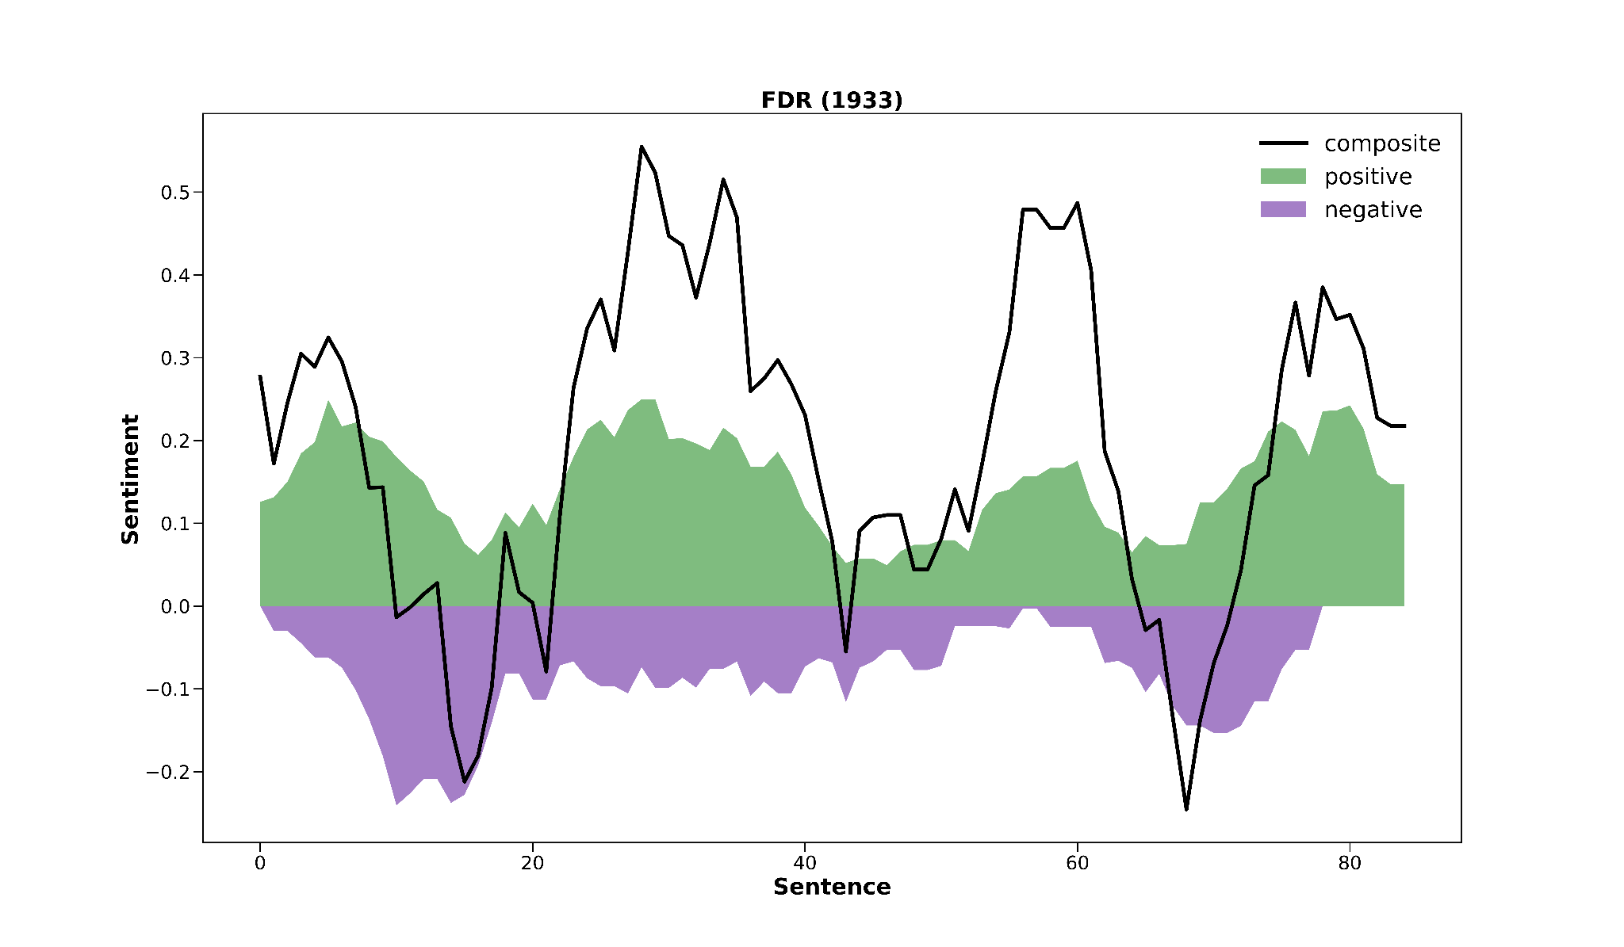
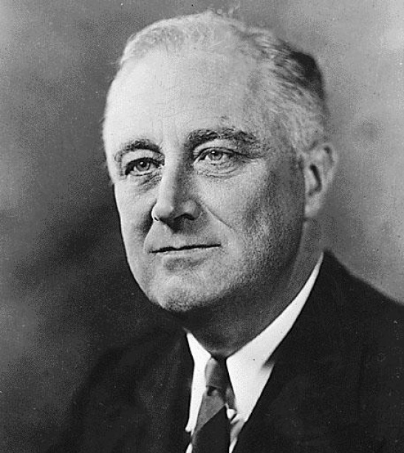
Notes:
Looking at that speech, you can see that is it pretty balanced which is interesting considering the great depression, maybe makes sense because hes needs to provide hope in a time of hardship

Slide 9
—Franklin D. Roosevelt
only a foolish optimist can deny the dark realities of the moment.
Compound: -0.0258 Neg: 0.283 Neu: 0.503 Pos: 0.214
Notes:
Looking deeper into the speech, he says more towards the beginning ‘ ‘. Now vader views this sentence as fairly neutra according to the compound scorel. Why you may ask?

Slide 10
Word Breakdown
Foolish | Negative: -1.1
Optimist | Positive: 2.4
Deny | Negative: -1.4
Notes:
Because it only recongized these three words. And you can see their scores up there as well.

Slide 11
—Franklin D. Roosevelt
only a foolish optimist can deny the dark realities of the moment.
Compound: -0.0258 Neg: 0.283 Neu: 0.503 Pos: 0.214
Notes:
Now looking back at the speech our brains think at foolish optimist has one meaning which is negative. But vader only sees these two separate words. Foolish is negative, but optimist has more than double the positive score, bringing this more to neutrality.

Slide 12
—Franklin D. Roosevelt
stripped of the lure of profit by which to induce our people to follow their false leadership,
they have resorted to exhortations, pleading tearfully for restored confidence.
Compound: 0.823 Neg: 0.0 Neu: 0.736 Pos: 0.264
Notes:
Later on in the speech he says ‘ ‘. There are some like myself that needed a bit of a translations so he is saying: the leaders being criticized have lost the ability to motivate their followers by promising financial gain or profit. Instead, they are now using emotional pleas and appeals. Vader believes this sentence to be fairly positive with a compoud score of .823. Lets say why.

Slide 13
Word Breakdown
Profit | Positive: 1.9
Restored | Positive: 1.4
Confidence | Positive: 2.3
Notes:
Again it only picked up on three words which were pretty loaded in terms of positive sentiment.

Slide 14
—Franklin D. Roosevelt
stripped of the lure of profit by which to induce our people to follow their false leadership,
they have resorted to exhortations, pleading tearfully for restored confidence.
Compound: 0.823 Neg: 0.0 Neu: 0.736 Pos: 0.264
Notes:
Again it does not picked things like ‘false leadership’ or ‘ pleading tearfully’ and individually these are all viewed with neutrality. This is where the compound score can be a bit mysterious because the neutral score is very high and the positive score is low bit the compound score is very much high. Sometimes the compound score can be a bit iffy in that since so its important to consider that when using vader. I will now pass it off the Clayton who will give us a more modern example of how vader analysis these speeches.

Slide 15
1921
2020
1933
The Roaring 20s
COVID-19
Lang. D. “White Angel Bread Line, San Francisco”
The Great Depression
H. Ford and the Model-T
Workers preparing to disinfect a central railway station
Notes:
Do we want breadcrumbs? What about titles?; Text for the COVID-19 image. Can this be agenda and transition slide?

Slide 16
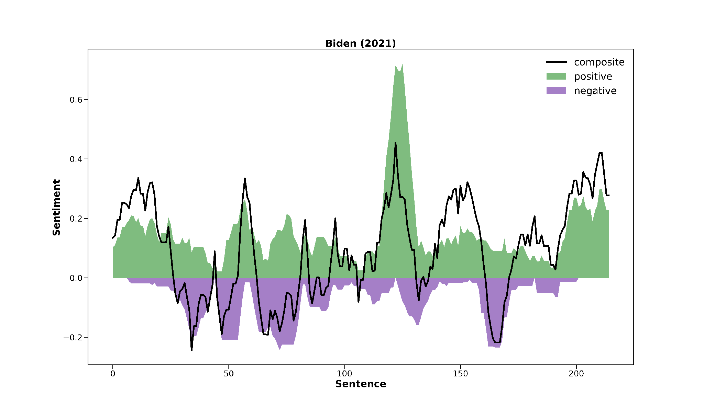
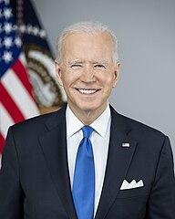
American
virtues
“writing our story”
Jan. 6,
gratitude
COVID,
climate crisis
extremism
Notes:
Here’s how historical (current?) events map onto Biden’s speech, to give you context
A good mix of setting the stakes and inspiring hope
One thing to note is large spikes, what’s going on here?

Slide 17
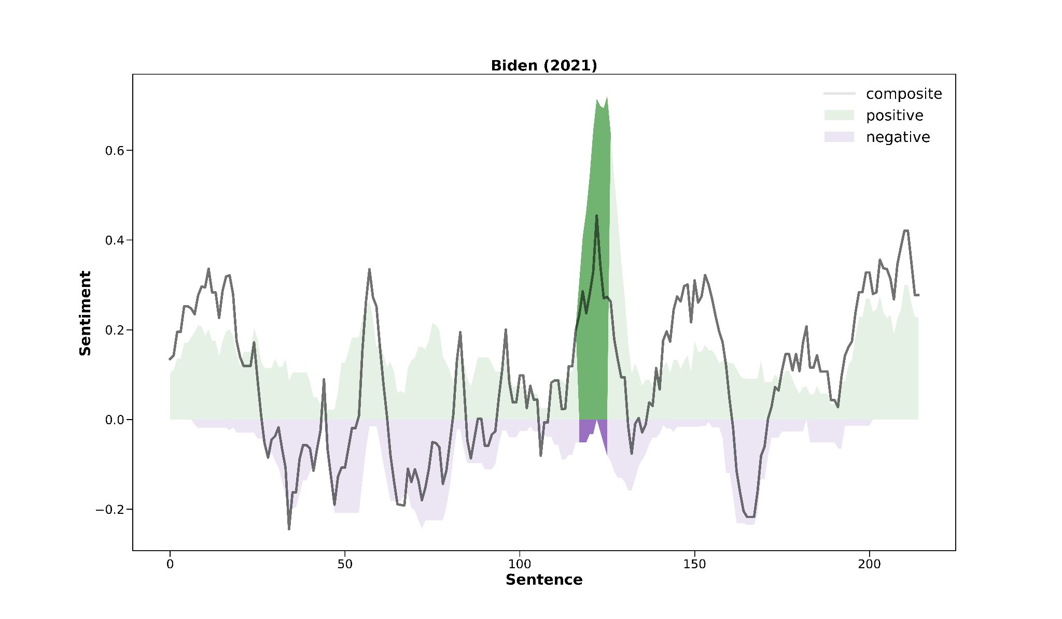
117- Many centuries ago, Saint Augustine, a saint of my church, wrote that a people was a multitude defined by the common objects of their love. [0.67]
118 - What are the common objects we love that define us as americans? [0.64]
120-126 - Opportunity. [0.42] Security. [0.34] Liberty. [0.53] Dignity. [0.40] Respect. [0.48] Honor. [0.49] And, yes, the truth. [0.61]
Notes:
These areas represent a rhetorical device in speeches: enumeration
Biden lists American values, which are each tokenized as a separate chunk
These chunks are all emotion-carrying words, as the point of enumeration is to build momentum; thus a spike
This is an example of how a structure of a speech impacts its sentiment scoring if tokenization is left on its own

Slide 18

162 - We face an attack on democracy and on truth. [-0.20]
163 - A raging virus. [-0.53]
164 - Growing inequity. [0.18]
165 - The sting of systemic racism. [-0.62]
166 - A climate in crisis. [-0.62]
Notes:
Another example of enumeration but from a negative point of view
Note that VADER has a false positive here with “growing inequity” due to the positive connotation of “growth”

Slide 19
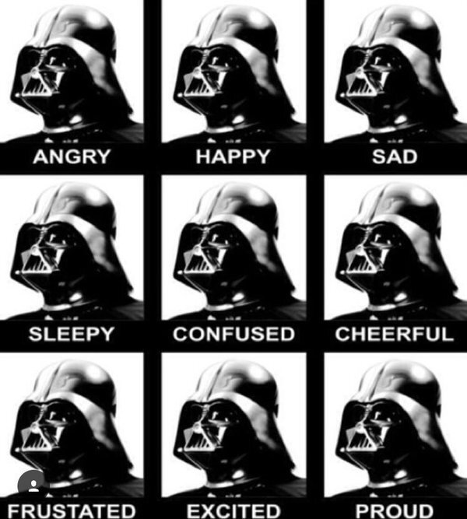
Conclusions
I. VADER misses negations, despite being rules-based
II. Overall, VADER captures most sentiment; especially when orators use enumeration
III. Mixed emotions in political speech can often confuse VADER in determining sentiment
Notes:
So what are our main takeaways?

Slide 20
Questions?

